Slide 1

FIREWALL

Slide 2
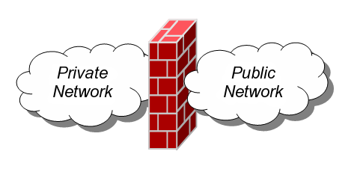
What Is a Firewall?
Definition:
A Network Firewall is a system or group of systems used to control access between two networks -- a trusted network and an un-trusted network -- using pre-configured rules or filters.

Slide 3

What is a Firewall?
Device that provides secure connectivity between networks (internal/external; varying levels of trust)
Used to implement and enforce a security policy for communication between networks
Firewalls can either be hardware and/or software based.

Slide 4
What is a Firewall?
It is the combination product that provide the function of screening routers, proxy servers, network address translation, plus stateful inspection.
Firewalls can be composed of a single router, multiple routers, a single host system or multiple hosts running firewall software, hardware appliances specifically designed to provide firewall services, or any combination thereof.

Slide 5
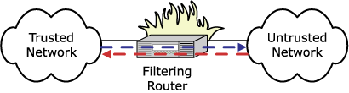
What is a Firewall?
Device that provides secure connectivity between networks (internal/external; varying levels of trust)
Used to implement and enforce a security policy for communication between networks
Firewalls can either be hardware and/or software based.

Slide 6
Firewalls History …A Brief Look
Firewall technology emerged in the late 1980s when the Internet was a fairly new technology in terms of its global use and connectivity.
The first paper published on firewall technology was in 1988, when Jeff Mogul from Digital Equipment Corporatin (DEC) developed filter systems known as packet filter firewalls.

Slide 7
Firewalls History …A Brief Look
From 1980-1990 two colleagues from AT&T Company, developed the second generation of firewalls known as circuit level firewalls.
Publications by Gene Spafford of Purdue University, Bill Cheswick at AT&T Laboratories introduced a third generation firewall. also known as proxy based firewalls.

Slide 8
Firewalls History …A Brief Look
In 1994 Check Point Software Technologies built readily available software known as FireWall-1.
Cisco, one of the largest internet security companies in the world released their PIX ” Private Internet EXchange ” product to the public in 1997.

Slide 9
Network Firewall Architectures
Screening Router
Simple Firewall
Multi-Legged firewall
Firewall Sandwich
Layered Security Architecture

Slide 10
Screening Router

Slide 11
Simple Firewall

Slide 12
DMZ Firewall

Slide 13
Firewall Sandwich

Slide 14
Layered Firewall

Slide 15
Types of Firewalls
Packet Filtering
Stateful Packet Inspection
Application Gateways/Proxies
Adaptive Proxies
Circuit Level Gateway

Slide 16
Packet Filtering Firewall
A packet filtering firewall does exactly what its name implies -- it filters packets.
As each packet passes through the firewall, it is examined and information contained in the header is compared to a pre-configured set of rules or filters.
An allow or deny decision is made based on the results of the comparison.
Each packet is examined individually without regard to other packets that are part of the same connection.

Slide 17
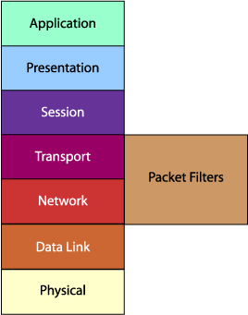
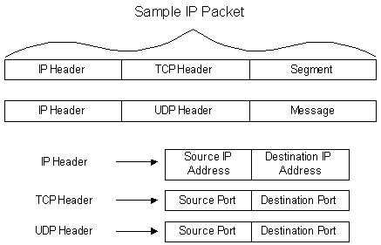
Packet Filtering Firewall
A packet filtering firewall is often called a network layer firewall because the filtering is primarily done at the network layer (layer three) or the transport layer (layer four) of the OSI reference model.

Slide 18
Packet Filtering Firewall
Packet filtering rules or filters can be configured to allow or deny traffic based on one or more of the following variables:
Source IP address
Destination IP address
Protocol type (TCP/UDP)
Source port
Destination port

Slide 19
Packet Filtering Firewall
Advantages :
Packet filtering is typically faster than other packet screening methods.
Packet filtering firewalls can be implemented easily in a network.
They typically require no additional configuration for clients.
They can be implemented in a transparent mode.
Packet filtering firewalls are typically less expensive.

Slide 20
Packet Filtering Firewall
Disadvantages:
Packet filtering firewalls allow a direct connection to be made between the two endpoints.
If ports are open, they are open to all traffic passing through that port, which in effect leaves a security hole in your network.
Defining rules and filters on a packet filtering firewall can be a complex task.
Packet filtering firewalls are prone to certain types of attacks. Since packet inspection goes no deeper than the packet header information

Slide 21
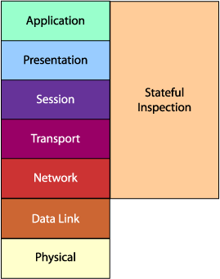
Stateful Packet Inspection
Stateful packet inspection uses the same fundamental packet screening technique that packet filtering does. In addition, it examines the packet header information from the network layer of the OSI model to the application layer to verify that the packet is part of a legitimate connection and the protocols are behaving as expected.

Slide 22
Stateful Packet Inspection Firewall
As packets pass through the firewall, packet header information is examined and fed into a dynamic state table where it is stored. The packets are compared to pre-configured rules or filters and allow or deny decisions are made based on the results of the comparison.
The data in the state table is then used to evaluate subsequent packets to verify that they are part of the same connection.

Slide 23
Stateful Packet Inspection Firewall
This method can make decisions based on one or more of the following:
Source IP address
Destination IP address
Protocol type (TCP/UDP)
Source port
Destination port
Connection state

Slide 24
Stateful Packet Inspection Firewall
The connection state is derived from information gathered in previous packets.
It is an essential factor in making the decision for new communication attempts.
Stateful packet inspection compares the packets against the rules or filters and then checks the dynamic state table to verify that the packets are part of a valid, established connection.
By having the ability to "remember" the status of a connection, this method of packet screening is better equipped to guard against attacks than standard packet filtering.

Slide 25
Stateful Packet Inspection
Advantages :
Like packet filtering firewalls, have very little impact on network performance.
More secure than basic packet filtering firewalls. Because stateful packet inspection digs deeper into the packet header information to determine the connection state between endpoints.
Usually it have some logging capabilities. Logging can help identify and track the different types of traffic that pass though the firewall.

Slide 26
Stateful Packet Inspection
Disadvantages:
Like packet filtering, stateful packet inspection does not break the client/server model and therefore allows a direct connection to be made between the two endpoints
Rules and filters in this packet screening method can become complex, hard to manage, prone to error and difficult to test.

Slide 27
Application Gateways/Proxies
The proxy plays middleman in all connection attempts.
The application gateway/proxy acts as an intermediary between the two endpoints. This packet screening method actually breaks the client/server model in that two connections are required: one from the source to the gateway/proxy and one from the gateway/proxy to the destination. Each endpoint can only communicate with the other by going through the gateway/proxy.

Slide 28
Application Gateways/Proxies
This type of firewall operates at the application level of the OSI model. For source and destination endpoints to be able to communicate with each other, a proxy service must be implemented for each application protocol.
The gateways/proxies are carefully designed to be reliable and secure because they are the only connection point between the two networks.

Slide 29
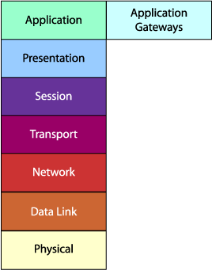
Application Gateways/Proxies

Slide 30

Application Gateways/Proxies Firewall
When a client issues a request from the untrusted network, a connection is established with the application gateway/proxy. The proxy determines if the request is valid (by comparing it to any rules or filters) and then sends a new request on behalf of the client to the destination. By using this method, a direct connection is never made from the trusted network to the untrusted network and the request appears to have originated from the application gateway/proxy.
Application Gateway (Proxy service)
Untrusted Network
Work Station

Slide 31
Application Gateways/Proxies Firewall
The response is sent back to the application gateway/proxy, which determines if it is valid and then sends it on to the client.
By breaking the client/server model, this type of firewall can effectively hide the trusted network from the untrusted network.
It is important to note that the application gateway/proxy actually builds a new request, only copying known acceptable commands before sending it on to the destination.
Unlike packet filtering and stateful packet inspection, an application gateway/proxy can see all aspects of the application layer so it can look for more specific pieces of information

Slide 32
Application Gateways/Proxies
Advantages:
Application gateways/proxies do not allow a direct connection to be made between endpoints. They actually break the client/server model.
Typically have the best content filtering capabilities. Since they have the ability to examine the payload of the packet, they are capable of making decisions based on content.
Allow the network administrator to have more control over traffic passing through the firewall. They can permit or deny specific applications or specific features of an application.

Slide 33
Application Gateways/Proxies
Disadvantages:
The most significant weakness is the impact they can have on performance. It requires more processing power and has the potential to become a bottleneck for the network.
Typically require additional client configuration. Clients on the network may require specialized software or configuration changes to be able to connect to the application gateway/proxy.

Slide 34
Circuit-level Gateway
Unlike a packet filtering firewall, a circuit-level gateway does not examine individual packets. Instead, circuit-level gateways monitor TCP or UDP sessions.
Once a session has been established, it leaves the port open to allow all other packets belonging to that session to pass. The port is closed when the session is terminated.
circuit-level gateways operate at the transport layer (layer 4) of the OSI model.

Slide 35
Linux Firewall
Any command or configuration file that is configured to block data from coming into your system or LAN is a firewall.
The Linux has 2 built-in firewalls Ipchains and Iptables.
Iptables is easy to configure and manage thus widely used.
Iptables commands are connected in chains.
Each command is used to block or allow data associated with specific protocol.

Slide 36
Configuring Iptables
The Iptables command is based on regulating data traffic in 3 directions
In
Out
Through
You can configure Iptables to stop data from coming in from an outside network.
You can configure Iptables to stop data from going out.
And you can configure Iptables to regulate data that is forwarded.

Slide 37
Configuring Iptables
3 default chains that control all traffic to flow through the firewall
INPUT
FORWARD
OUTPUT
Along with these predefined chains users can define their own chains also.
You can define rules to block or allow data in one of these chains or can create your own chain.
The Other 2 chains are
PREROUTING
POSTROUTING

Slide 38
Configuring Iptables
The Iptables command format is as follows
Iptables –t table option pattern –j target
The –t table option tells which table to use.
3 basic tables are available :-
Filter
NAT
MANGLE
The NAT table supports network address translation
The filter table allows you to block or allow specific types of network traffic

Slide 39
Configuring Iptables
The mangle table rules allow modifications to packets.
Options for Iptables
-A chain rule appends a rule to the end of a chain
-D chain number deletes the rule number from a chain
-F chain flushes or deletes all rules in a chain
-I chain number rule inserts a rule in a chain with the specified rule number
-L chain lists the current rules in the chain
-N chain starts a new chain
-X chain deletes a user defined chain

Slide 40
Configuring Iptables
The Iptables –L command lists all of the current rules on all chains.
Eg of Iptables command
# iptables –A FORWARD –p icmp –icmp-type echo-request –m limit –limit 1/s –j ACCEPT
The above command appends a limit of a packet every second to the ping command that is forwarded through your computer thus preventing the ping of death attack.

Slide 41
Configuring Iptables
Switches for Iptables
--dport port
specifies the destination TCP/IP port number
--icmp-type message
Allows you to specify the type of icmp message echo-request is a message sent by a ping command
-j action
Defines the action to be taken if the rule of the command is satisfied normally ACCEPT, DROP, REJECT or LOG
--limit time
Sets an allowable rate for a specific message. Can be in seconds, minutes, hours or days. Eg 2/s = 2 per second

Slide 42
Configuring Iptables
-m condition
Looks at the data for a match maybe a protocol such as TCP or UDP or a condition such as a limit.
-p protocol
Checks the data for a specific protocol such as TCP or UDP
-s ip address
Specifies a source ip address
--sport port
Sets a source TCP/IP port

Slide 43
Configuring Iptables
--tcp-flags fl1,……
Looks for specified flags in a TCP packet
SYN packets are sent from a client & expect a reply
ACK packets acknowledge SYN request
FIN the final packet in a communication
RST packets tell a client that a request has been rejected

Slide 44
Configuring Iptables
Actions for Iptables
-j ACCEPT
Allows packets that match the specified rule into, out of, or forward through the firewall
-j DROP
Stops the packet that match the specified rule without informing the source
-j REJECT
Stops packets that match the specified rule with an error to the source
-j LOG
Logs a of the matching packet in /var/log/messages

Slide 45
Configuring Iptables
! The exclamation mark is used to tell Iptables of the exceptions in a rule
Some examples of Iptables command
Iptables –A FORWARD –s 192.168.10.1 –p icmp –j ACCEPT
Iptables –A FORWARD –s !192.168.10.1 –p icmp –j ACCEPT
Iptables –A FORWARD –s 192.168.10.0/24 –p icmp –j ACCEPT
Iptables –I test –p tcp –m tcp –dport 80 –tcp-flags SYNC,RST,ACK SYN –j ACCEPT

Slide 46
Configuring Iptables
Saving configuration changes
The firewall configuration is saved to
/etc/sysconfig/iptables
To save the changes the command is
# service iptables save
To start the firewall the command is
# service iptables start

Slide 47
Configuring Iptables
Setting up IP Masquerading
Ip Masquerading allows you to hide the ip address of the computers on your LAN.
It replaces these ip addresses with the public ip address of your gateway
Eg
Iptables –t nat –A POSTROUTING –s 192.168.10.0/24 –o eth0 –j MASQUERADE

